Slide 1
Subtitle Detection in Video using OpenCV

Slide 2
Objective: Detect and highlight subtitles in a video using OpenCV.
Overview: Steps involved from reading the video to drawing bounding boxes around detected subtitles.

Slide 3
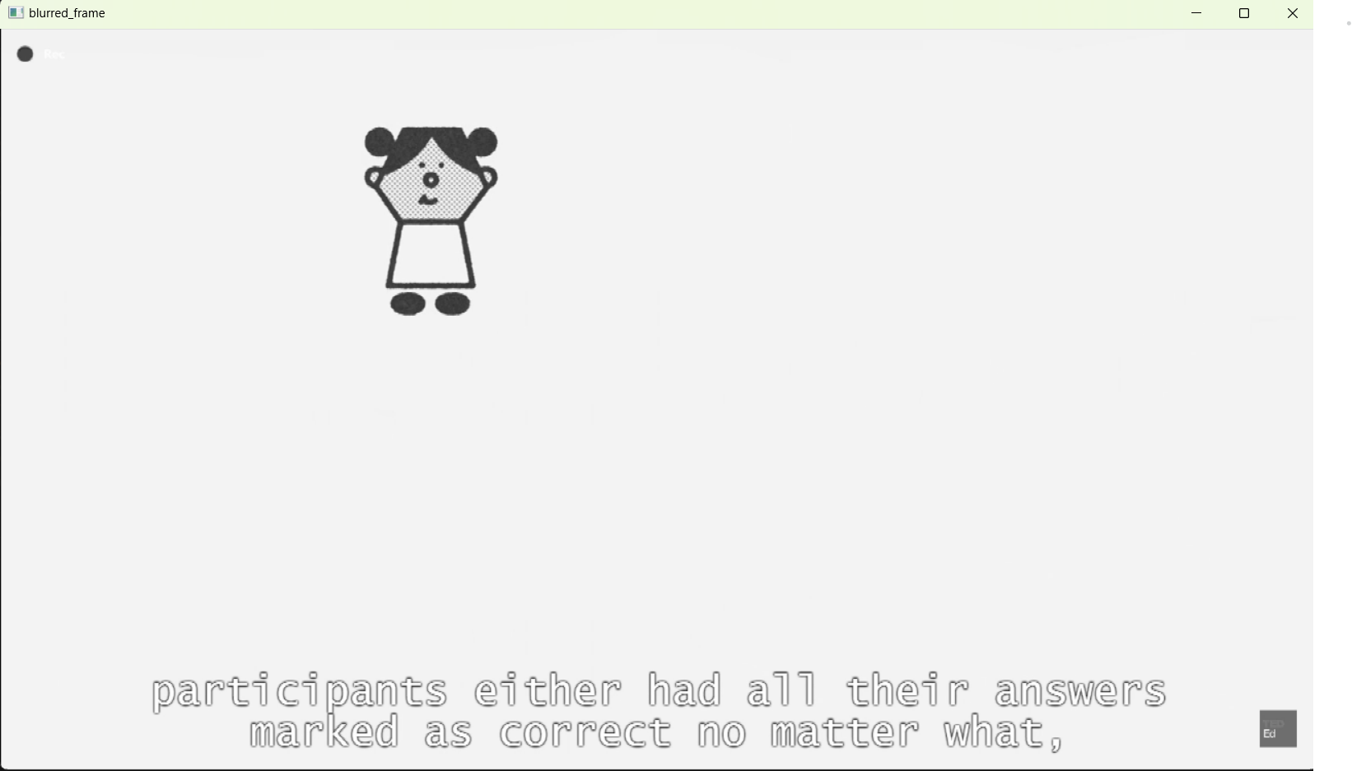
Reading and Processing Video Explanation: Use cv2.VideoCapture to read the video. Loop through each frame to process Preprocessing & Noise Removal Explanation: Convert frame to grayscale. Apply Gaussian Blur to reduce noise.

Slide 4

1. Thresholding Explanation: Apply adaptive thresholding to segment text from the background. Screen shoot for thresholding image

Slide 5
2. Contour Detection Explanation: Use cv2.findContours to detect contours which represent potential characters. 3. Bounding Box Calculation Explanation: Calculate bounding boxes for contours based on their area and position. 4. Merging Bounding Boxes to Form Words Explanation: Group close bounding boxes to form words. 5. Final Bounding Boxes Around Subtitles Explanation: Draw final bounding boxes around merged text regions to highlight subtitles.

